Slide 1
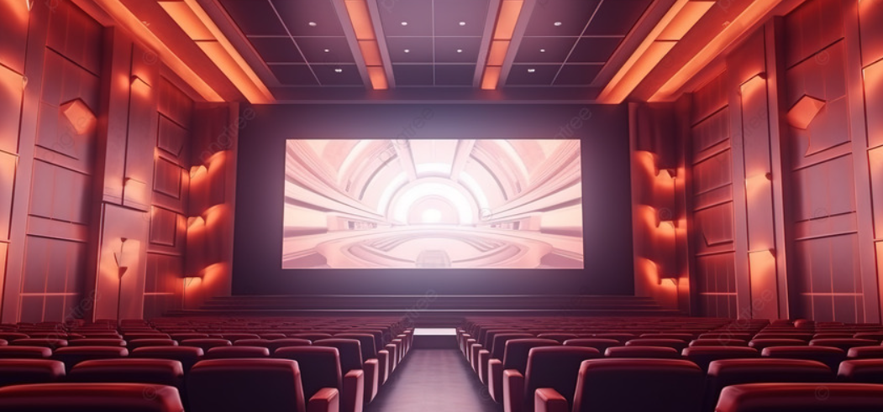
str VOX Ltd “Transforming Screens into Spectacles"
ARAVIND RAJ M

Slide 2

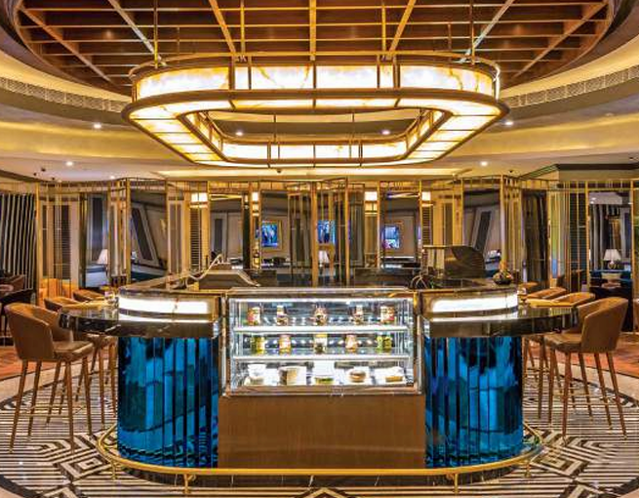
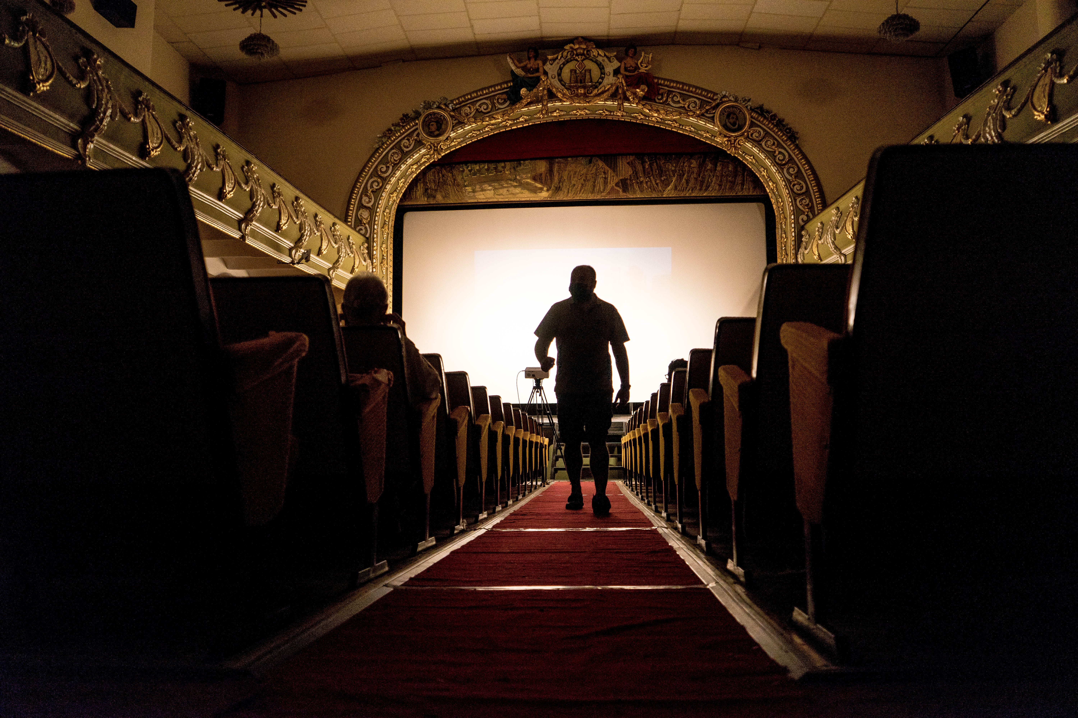

Agenda
Introduction
Market Potential
Awards
Matrix
Strategy
Franchisees
Investment
Professional Design

Slide 3




introduction
STR VOX Ltd formerly known as STR Cinemas, is an Indian multiplex chain based in Chennai. It was formed because of the merger between STR Cinemas and VOX Leisure Multiplex. STR pioneered the multiplex revolution in India by establishing the first multiplex cinema in 1995 at New Delhi. In 2020, STR Cinemas achieved the milestone of completing 25 years in the business. As of December 2020, STR VOX has 1712 screens across 359 properties in 114 cities (India and Sri Lanka).
It began its commercial operations in June 1995. The company was founded by Ajith Kumar who is the chairman and managing director of STR Cinemas. Ajith’s brother Sanjeev Kumar is the Joint Managing Director of STR Ltd. The company also operates a pro-active CSR wing under STR . In 2003, SBI Ventures invested ₹40 crore in STR when Village Roadshow decided to pull out of the partnership. The first STR Gold Screen was introduced in Forum Mall, Bengaluru.

Slide 4
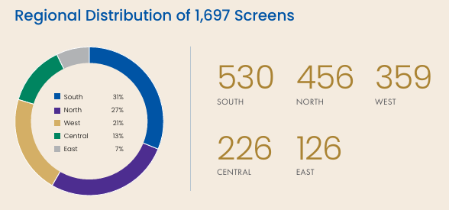
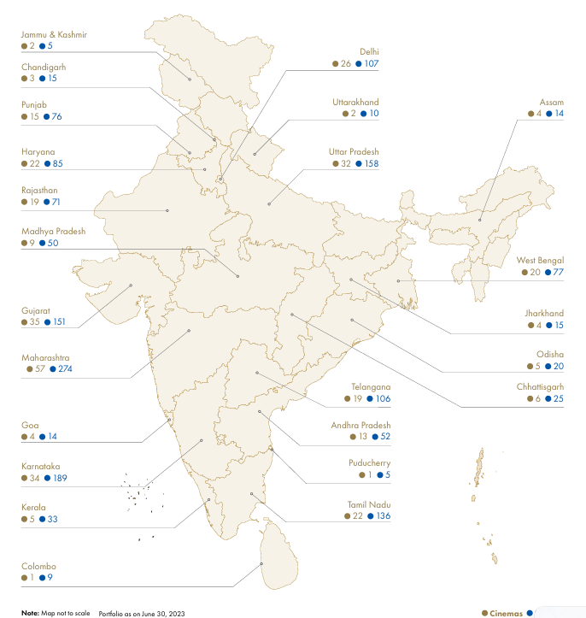
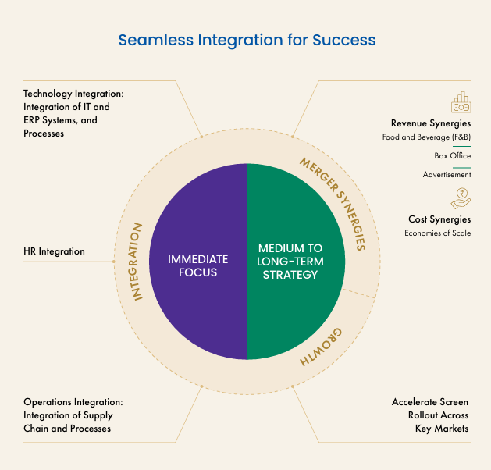
MARKET POTENTIONAL

Slide 5
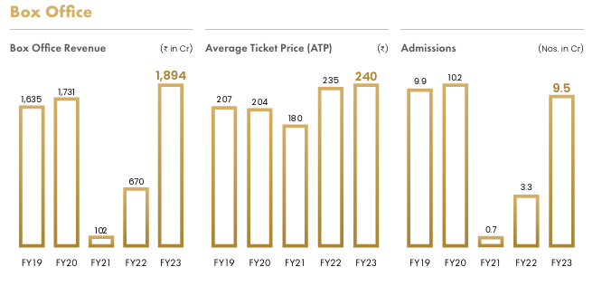
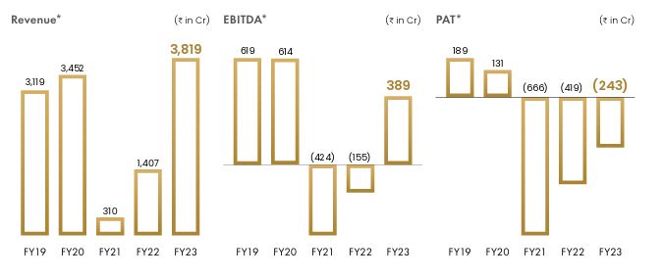
FINANCIAL PERFORMANCE
OPERATIONAL PERFORMANCE

Slide 6
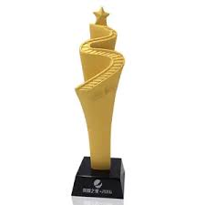



AWARDS
'ICICI Entertainment Retailer of the Year' Award
TAAL Multiplexer Award
Emerging Super brand of the year
Big Cine Expo Awards' Best Technology Adopter of the Year
2000
2005
2015
2018-2022

Slide 7
Matrix
STRENGTH
Strong Brand Image: STR Cinemas is one of the leading cinema chains in India, known for its quality offerings and innovative cinema experiences. It has built a strong brand image over the years.
Wide Presence: STR has a wide presence across major cities in India, including both metro and non-metro locations. This extensive network of multiplexes gives it a competitive edge in terms of market reach.
Diverse Offerings: STR offers diverse movie experiences, including IMAX screens, 4DX technology, luxury seating options, and gourmet food offerings. This variety caters to different customer preferences and enhances the overall moviegoing experience.
Innovative Technology: STR invests in innovative cinema technologies to stay ahead of the curve. Its commitment to upgrading screens, sound systems, and amenities keeps the cinema experience fresh and engaging for patrons.
WEAKNESS
Dependence on Film Industry: STR 's business is heavily dependent on the performance of the film industry. Fluctuations in film releases, box office performance, and content availability can impact its revenue and profitability.
Vulnerability to External Factors: STR 's operations are vulnerable to external factors such as regulatory changes, economic downturns, natural disasters, and public health crises (e.g., COVID-19 pandemic). These factors can disrupt operations and affect financial performance.
High Operating Costs: Maintaining high-quality facilities, technology upgrades, and providing premium services entail significant operating costs for STR . Managing these costs while remaining competitive can be challenging

Slide 8
Matrix
OPPORTUNITIES
Expansion into Tier 2 and Tier 3 Cities: STR has opportunities to expand its footprint into tier 2 and tier 3 cities where demand for quality cinema experiences is growing. These emerging markets present untapped potential for growth.
Diversification of Revenue streams: STR can explore diversification strategies beyond traditional cinema exhibition. This may include ventures into content production, digital streaming platforms, event hosting, and merchandising.
Focus on Premium Segments: With the rising disposable incomes and evolving preferences of urban consumers, STR can focus on catering to premium segments by offering exclusive experiences, luxury amenities, and personalized services
THREATS
Competition: STR faces competition from other multiplex chains, standalone theaters, and alternative entertainment options such as streaming services. Intense competition can impact market share and pricing power.
Piracy and Digital Disruption: Piracy and digital streaming platforms pose threats to the traditional cinema exhibition business model. The growing popularity of online streaming services and illegal downloads may reduce theater attendance.
Regulatory Challenges: Changes in government regulations related to entertainment taxes, censorship, licensing, and operating restrictions can pose challenges to STR 's operations and expansion plans.

Slide 9
strategy
Luxurious Amenities
Pampering patrons with luxurious amenities such as reclining seats, gourmet concessions, VIP lounges, and personalized service
Family-Friendly Environment
Creating a family-friendly environment with amenities like kids' play areas, family movie nights, and special discounts for families
Accessibility and Inclusivity
Prioritizing accessibility and inclusivity by offering facilities for patrons with disabilities, sensory-friendly screenings, and diverse programming
Membership and Loyalty Programs
Cinematic Experience Beyond Movies
Providing membership and loyalty programs with exclusive benefits, discounts, early access to tickets, and rewards for frequent patrons
Expanding beyond traditional movie screenings by offering live performances, concerts, stand-up comedy shows, and other entertainment events

Slide 10
FRANCHISEES
Operational Training
Technical Training
Customer Service Training
STR likely provides initial training to franchisees and their staff on various aspects of theater operations, including ticketing systems, concessions management, auditorium setup, cleaning procedures, safety protocols, and customer service standards.
Franchisees may receive technical training on the maintenance and troubleshooting of projection equipment, sound systems, lighting, HVAC systems, and other technical aspects of theater operations.
Training on the use of digital platforms for booking tickets, managing inventory, and analyzing sales data may also be provided.
STR emphasizes the importance of delivering high-quality customer service to enhance the moviegoing experience and build customer loyalty.
Franchisees may receive training on greeting customers, handling inquiries and complaints, assisting with ticket purchases, providing information about movie schedules, and ensuring a pleasant and comfortable environment for patrons

Slide 11
FRANCHISEES
Marketing and Promotions Support
Continuous Support and Guidance
Financial and Business Management Assistance
STR may offer marketing support to franchisees in the form of branding materials, advertising campaigns, promotional strategies, and social media engagement tactics.
Franchisees may receive guidance on local marketing initiatives, community outreach programs, loyalty programs, and partnership opportunities to attract and retain customers
STR likely provides ongoing support to franchisees through regular communication, site visits, performance evaluations, and feedback sessions.
Franchisees may have access to a dedicated support team or regional managers who can assist with operational issues, marketing challenges, and strategic planning
STR may offer guidance to franchisees on financial management, budgeting, forecasting, inventory control, pricing strategies, and cost optimization.
Franchisees may receive access to financial tools, reporting systems, and performance metrics to monitor business performance and make informed decisions

Slide 12
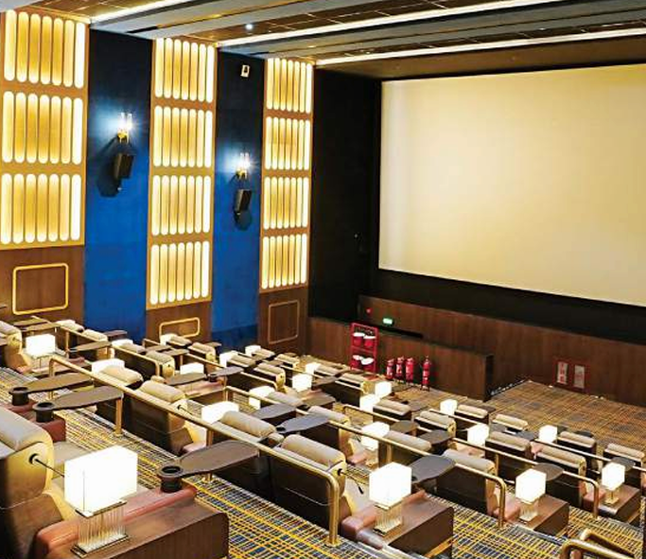
INVESTMENT
KEY BENEFITS
Established Brand and Market Leader
Steady Revenue stream
Growing Industry Demand
Diversification and Resilience
Innovative Offerings and Technology
strategic Partnerships and Content Access
Scalability and Growth Potential
Professional Management and Support
strong Financial Performance
Social and Cultural Impact
Investment : ₹1 Crore
Space Required : 10,000 SQ FT
ROI : Within 36 Months
Location
Tier 2 city in India
Target Audience
Families
young adults
Occupancy Rate
60% (average)
Food & Beverage Revenue
40% of ticket sales
Ticket Price
₹200 (average)

Slide 13
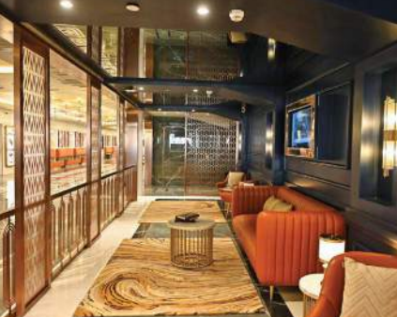
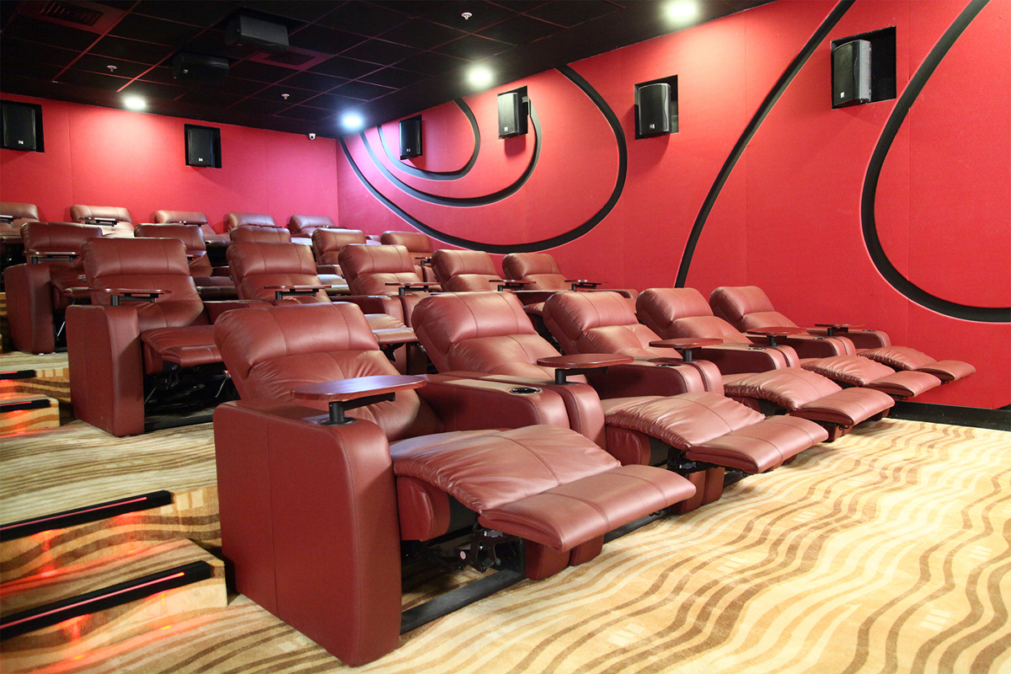
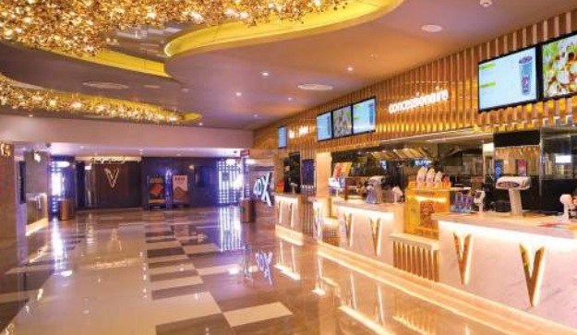
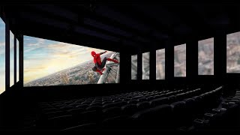
PROFESSIONAL DESIGN
Aesthetic Appeal
Luxury Seating
Innovative Screen Formats
Themed Interiors and Décor

Slide 14

Story
Screenplay
Dialogue
Direction
ARAVIND RAJ M
aravindbe96@gmail.com

